Slide 1


ARM DETECTION IN SURVEILLANCE VIDEOS BY USING DEEP LEARNING ALGORITHMS
Submitted in partial fulfilment of the requirements for the award of the Degree
of
BACHELOR OF TECHNOLOGY
in
COMPUTER SCIENCE AND ENGINEERING
Submitted by
N Manasa Venkata Naga Sai (193N1A0540)
K Pramod Sai (193N1A0524)
T Sai Darshan (193N1A0552)
S Raghavendra (193N1A0551)
B Keerthi (19711A0509)
Under the esteemed guidance of
C REKHA, M.Tech.,
Assistant Professor
DEPARTMENT OF COMPUTER SCIENCE AND ENGINEERING
P.V.K.K Institute of Technology
An ISO 9001-2015 Certified Institute
(Approved by AICTE, New Delhi & Affiliated to JNTUA, Anantapuramu.)
Sanapa Road, Rudrampeta, Anantapuramu-515001
Andhra Pradesh
2022-2023

Slide 2
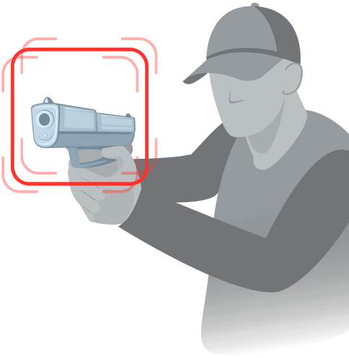
Contents
ABSTRACT
INTRODUCTION
EXISTING SYSTEM
PROPOSED SYSTEM
SYSTEM REQUIREMENTS
IMPLEMENTATION
SYSTEM DESIGN
RESULTS
CONCLUSION
REFERENCES

Slide 3
1. Abstract
In today's modern world, security and safety are major concerns. Closed Circuit Television cameras are used for surveillance and monitoring activities such as robberies, but these cameras and it still require human supervision and intervention. Additionally, it propagates to require a system that can detect illegal activities automatically. The challenge is made more difficult by observing from different angles and being hidden by the gun's owner and those nearby.

Slide 4
2. Introduction
Weapons have become a serious threat to public safety, and detecting them in images and videos can be challenging task for human operators.
The requirement is effective video surveillance systems to detect potential security threats and prevent violent incidents.
Automating weapon detection, which can significantly improve the accuracy and speed of detecting potentially dangerous situations.

Slide 5
3. Existing System
Traditional computer vision techniques for weapon detection rely on hand-crafted features and rule-based systems, which can be limited in their accuracy and robustness.
Surveillance video footage is fed to deep learning model of Object Detection module.
It requires a large amounts of data and computational resources to train, and may not always generalise well to new or unseen scenarios.

Slide 6
Disadvantages
Limited perfection due to the presence of false positives and false negatives.
Limited detection of certain types of weapons.
Scalability can be an issue due to the computational expense.

Slide 7

4. Proposed System
Proposed deep learning-based weapon detection system.
Able to identify a wider variety of weapons and improvised devices with fewer false positives and negatives.
Used both object classification and detection algorithms.

Slide 8
Advantages
1.better performance.
2.faster processing and analysis.
3.cost-effective.
4.Easy to deploy.

Slide 9
5. System Requirements
5.1 - Hardware Requirements
Processor - Pentium–IV and above
RAM - 4 GB (Minimum)
Hard Disk - 40 GB (Minimum)

Slide 10

5.2 - Software Requirements
Operating system - Windows 7 Ultimate or above.
Scripting Language. - Python (3.8.5)
Front-End - OpenCV
Back-End - YOLOv3, DarkNet
Python IDE - PyCharm

Slide 11
6. Implementation
Identify the type of weapon to be detected and collect a dataset of labeled images of the weapon.
Preprocess the dataset to normalize and resize the images, and split into training and testing sets.
Choose a deep learning architecture, such as a convolutional neural network, and train the model on the training set.
Implement the model in a software application or hardware system, depending on the use case.
Test the system for accuracy and reliability on real-world data.

Slide 12

6.1 - Algorithms
A. YOLOv3
YOLOv3 (You Only Look Once version 3) is an object detection algorithm in deep learning.
YOLOv3 uses Darknet neural network architecture that is optimal for small and efficient computer vision models.
The Algorithm YOLOv3 consists of two steps :
Image classification
Object Localization

Slide 13

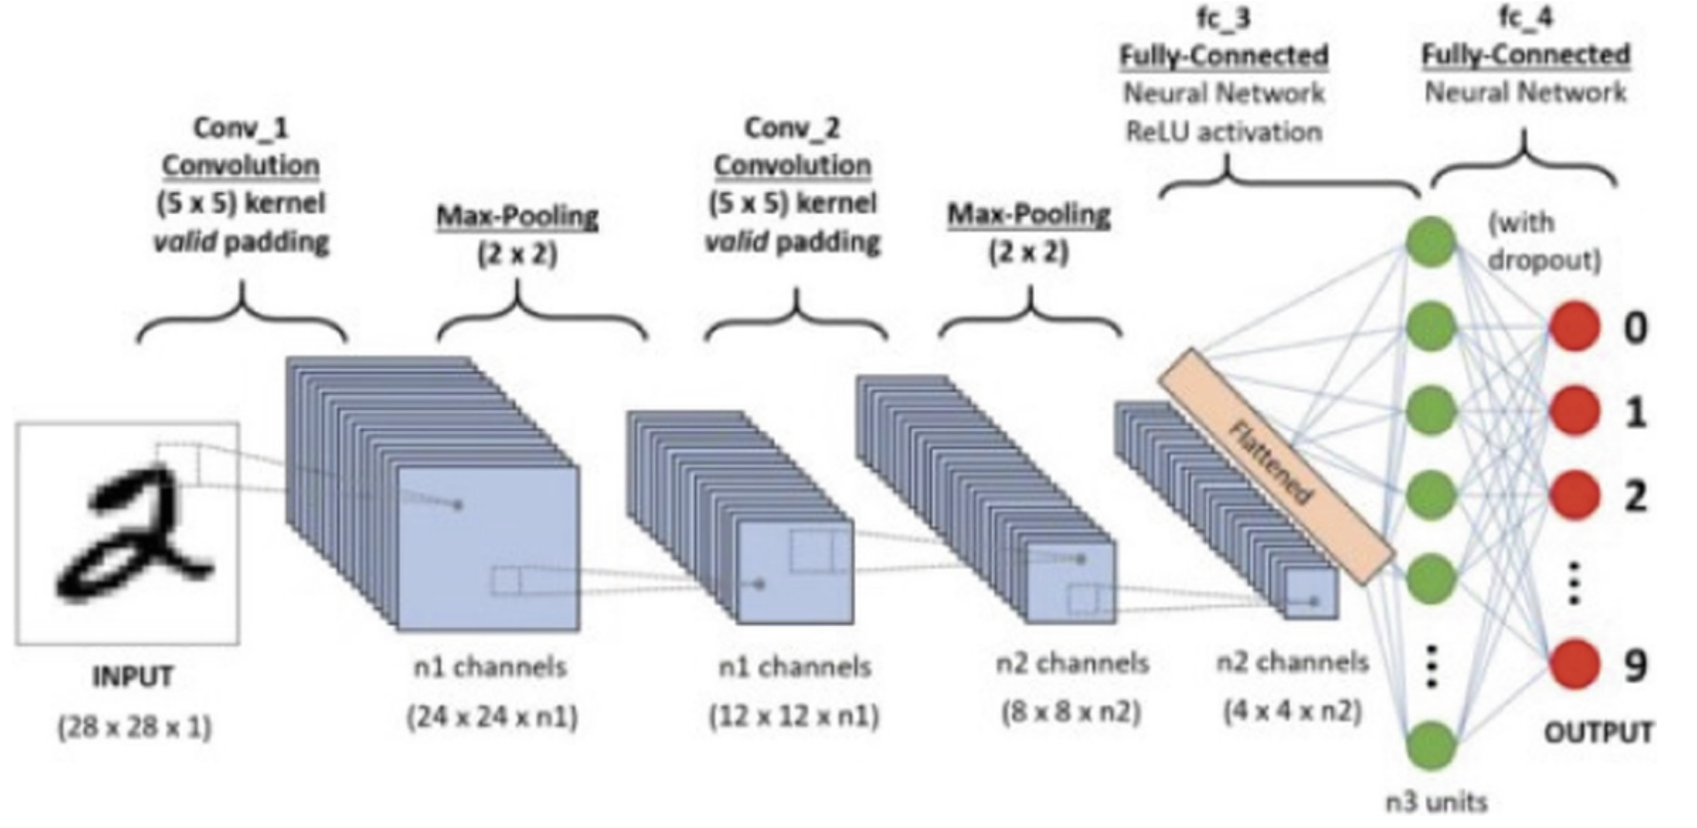
B. CNN
Convolutional neural networks are a type of deep learning algorithm used for image recognition and classification tasks.
CNNs are designed to automatically learn and extract features from images, using convolutional layers to identify patterns and learn features.

Slide 14
6.2 - Modules
Data Collection and Pre-Processing
Object Detection and Localization
Feature Extraction
Classification

Slide 15
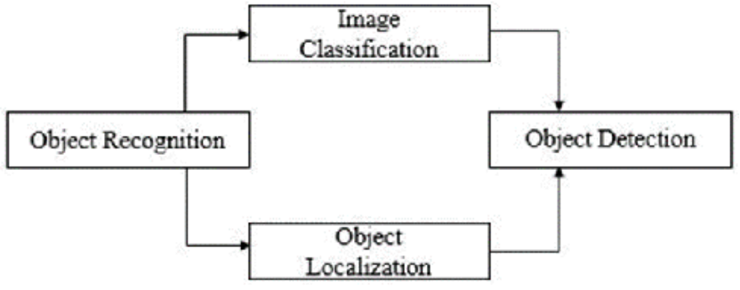
7. System Design
A. UML Diagram

Slide 16
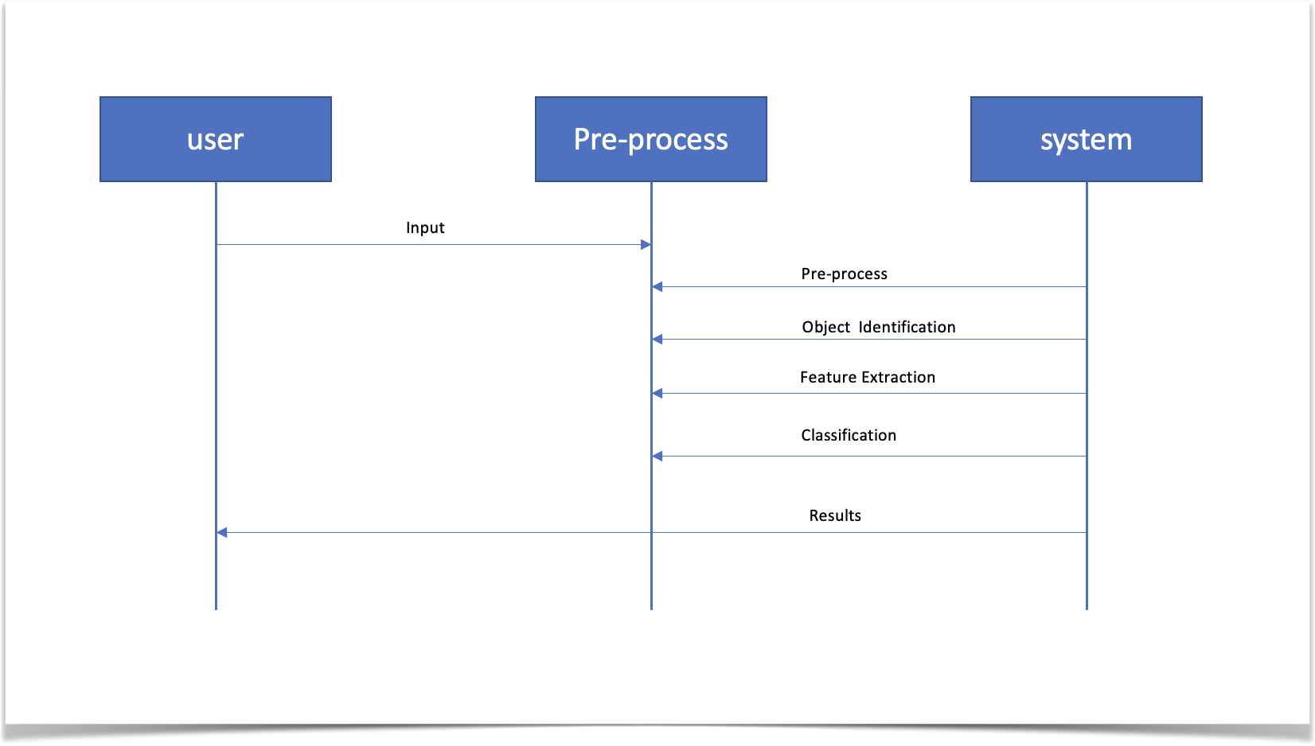
B. Sequence Diagram

Slide 17
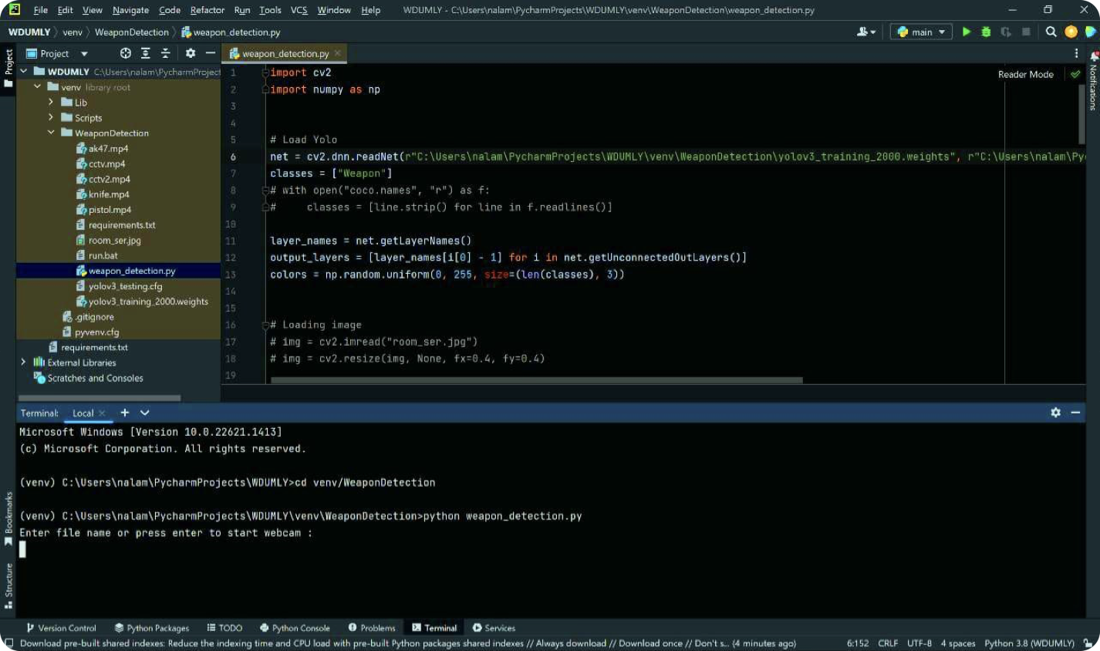
8. Results

Slide 18
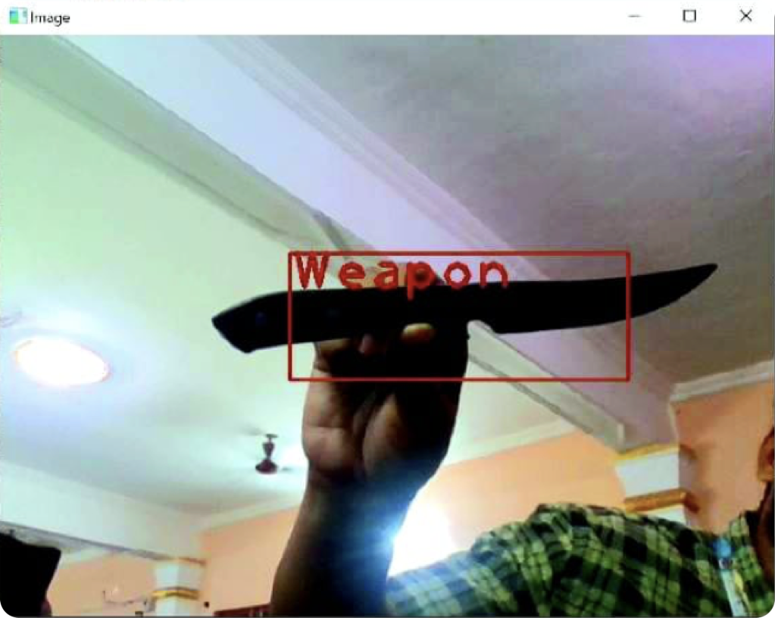

Slide 19

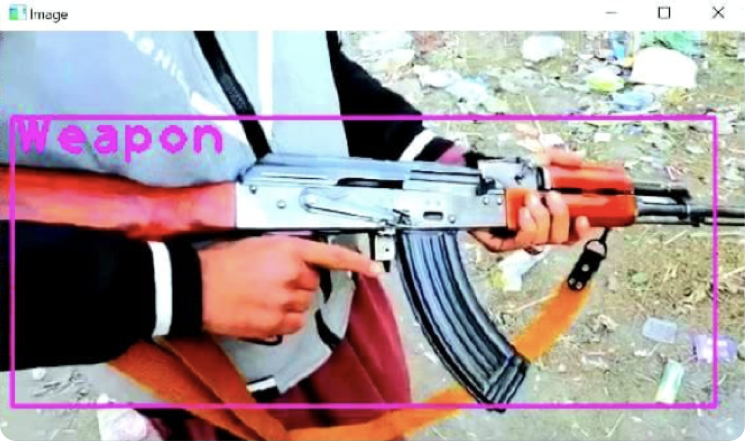
19

Slide 20
9. Conclusion
Enhance security in public spaces and improve safety.
High accuracy, quick processing times, and the ability to learn and adapt over time.
Limitations of existing systems, such as reducing false positives and improving real-time detection.
Also ensures the system's reliability and effectiveness in real-world scenarios.

Slide 21
10. References
Bhagyalakshmi, P.; Indhumathi, P.; Lakshmi, R.; Bhavadharini, D. Real Time Video Surveillance for Automated Weapon Detection. Int. J. Trend Sci. Res. Dev. 2019,
Verma, G.K.; Dhillon, A. A Handheld Gun Detection using Faster R-CNN Deep Learning. In Proceedings of the 7th International Conference on Computer and Communication Technology, Allahabad, India, 24–26 November 2017
Warsi, A.; Abdullah, M.; Husen, M.N.; Yahya, M. Automatic Handgun and Knife Detection Algorithms: A Review. In Proceedings of the 14th International Conference on Ubiquitous Information Management and Communication, Taichung, Taiwan, 3–5 January 2020
Grega, M.; Matiolański, A.; Guzik, P.; Leszczuk, M. Automated detection of firearms and knives in a CCTV image. Sensors 2016
Tiwari, R.K.; Verma, G.K. A Computer Vision based Framework for Visual Gun Detection Using Harris Interest Point Detector. Procedia Comput. Sci. 2015

Slide 22
THANK YOU !

